Slide 1
The Middle Ages
So what comes to mind when we say “Middle Ages?”

Slide 2
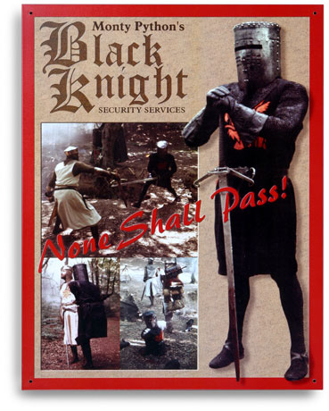
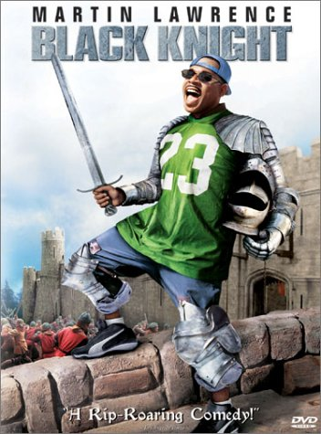
Knights!

Slide 3
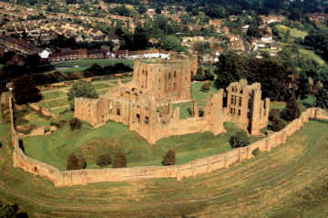
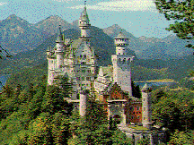
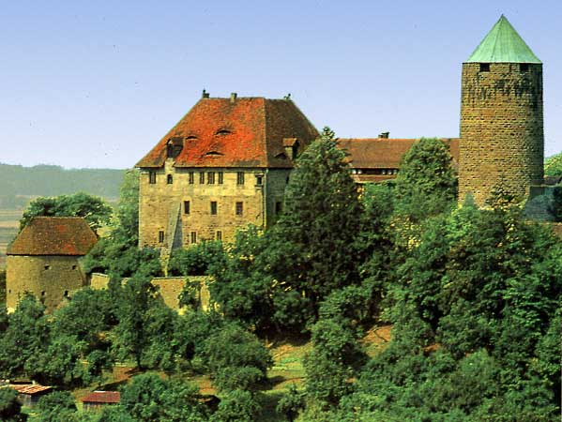
Castles!

Slide 4
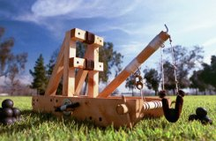
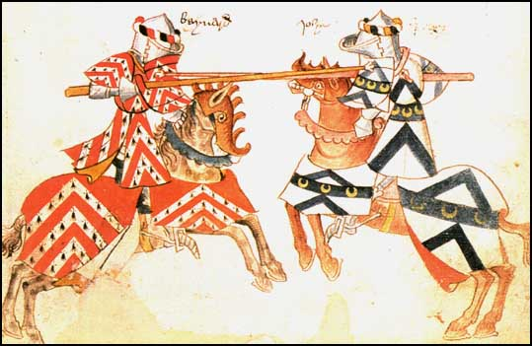
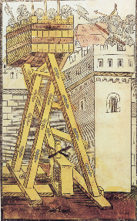
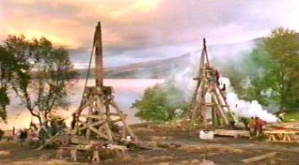
Feudal Warfare!!!!

Slide 5
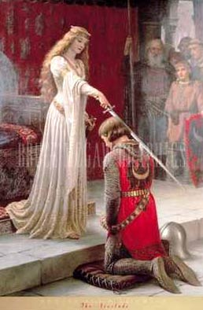
Chivalry- code of honor

Slide 6
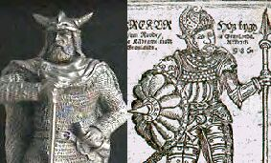
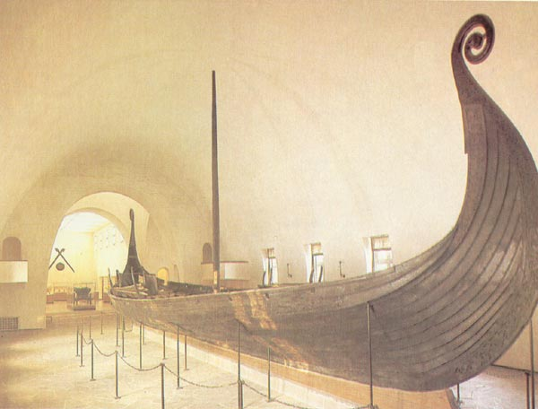
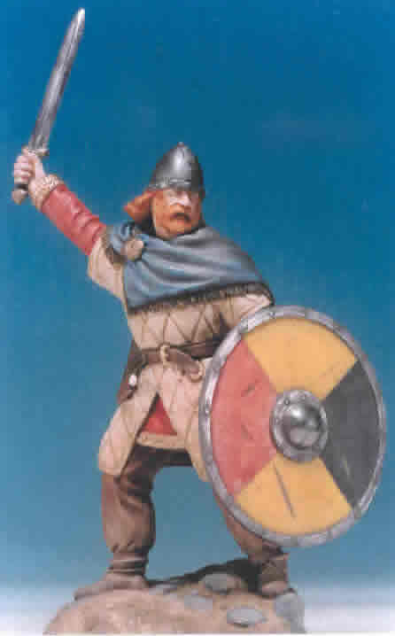
Vikings!

Slide 7
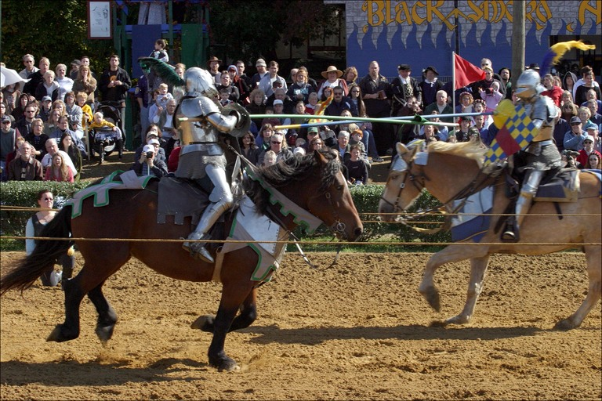
Jousting Tournaments

Slide 8
The Middle Ages were a dangerous time in Europe
The strong empires of Rome and Greece that protected trade routes and encouraged science and freedom were gone.
Education died out
Only the Christian Church kept education alive in monasteries
  Hand copied books

Slide 9
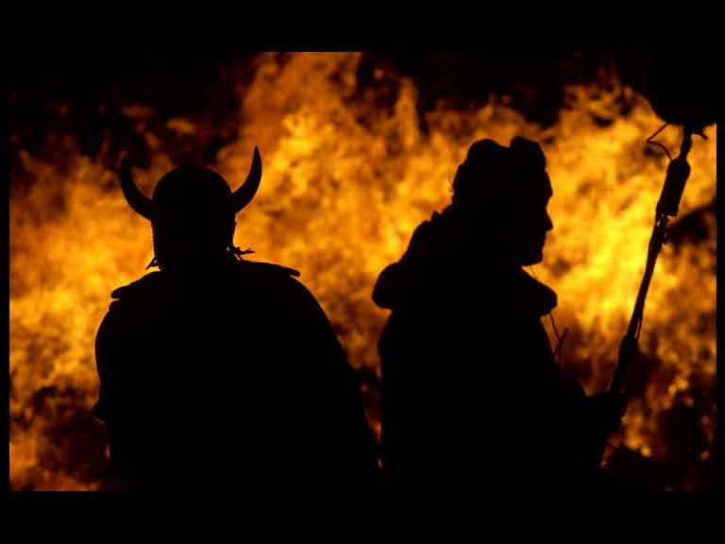
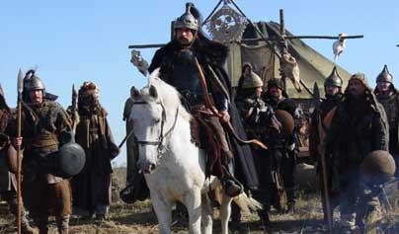
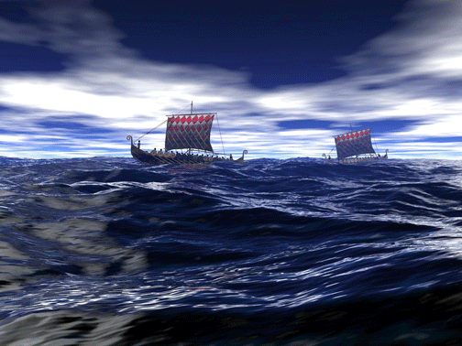
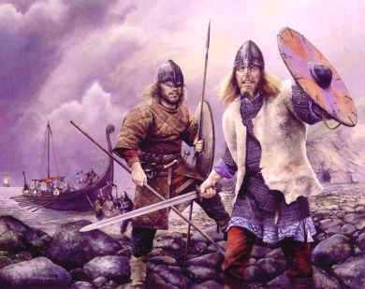
Invaders and Raiders make life dangerous
Vikings
Huns
Neighboring Tribes

Slide 10
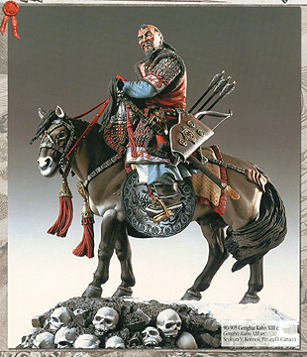
Invaders and Raiders
Genghis Kahn
Mongolian warrior
  A particular problem for the Russians.
  Mongols conquered Russia and ruled it for 400 years
  Russia has been behind the rest of Europe ever since

Slide 11
So Who is Where?
Angles and Saxons in Britain.
  Thus the term “Anglo-Saxon”
  Also where we get the term “England”
    (from “Angle land”)
Franks in France (well no duh!)
Goths and Visigoths in Italy, Spain and Eastern Europe
Russ in Russia (no kidding)
Slavs in Eastern Europe
A mixture of everybody in Germany

Slide 12
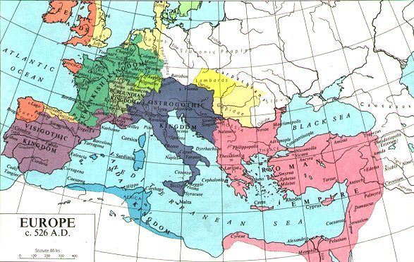
Angles and Saxons
Russ
Slavs
Note: The Eastern
Roman Empire is
Still going strong

Slide 13
No Strong Central Govt.
So how will we be protected?
Lack of central government for protection leads to rise of Feudalism

Slide 14
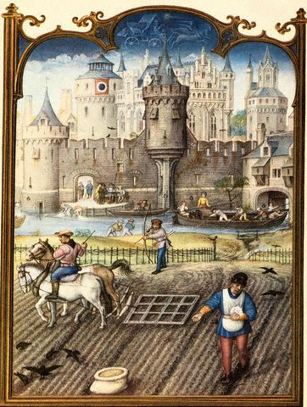
What is Feudalism?
Feudalism: “loosely organized system of government in which local lords governed their own lands but owed military service and other support to a greater lord.”

Slide 15
See Bubba’s Kingdom

Slide 16
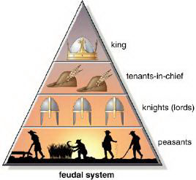
Feudalism (political system)
So who is in charge?
The kings had plenty of land; but he could not control it all
  So he gave land to lords in exchange for protection, loyalty and $.
Lords then gave their land to knights in exchange for protection, loyalty and $.
Knights let serfs (peasants) work the land and he would protect them.
Serfs got food and shelter.
Thus, each person had rights and responsibilities
Higher lords

Slide 17
Manor Life
So where do the people live?
In Medieval Europe, people lived on manors
  self-sufficient communities consisting of a castle, church, village and surrounding farmlands.
  Serfs work land and give part of their crops to the local (land) lord, for letting them farm the land.

Slide 18
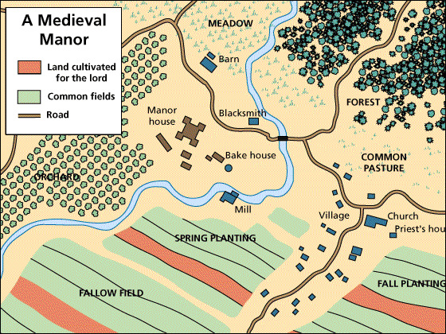
Common Pasture
(or "Green")

Slide 19
Problems with Feudalism
Possible to have allegiances to more than one person
No strong central government
  King must ask his lords for knights in time of war
  King must ask his lords for money to pay for things
  Lords hold most of the power
    Lords constantly fighting among themselves.

Slide 20
How to Gain / Stay in Power
GET More LAND!!
  More land = more crops = more $
  How to Get More Land?
    Conquer it
      Medieval times saw constant fighting
    Marry into it
Make Alliances
  It helps to have friends
    Marry off your daughter to secure an alliance

Slide 21
OK, but lets get to the stuff you all want to know
  Knights in shining armor, Castles, Horses, Warfare, and general mayhem.

Slide 22
See Castles Unit

Slide 23
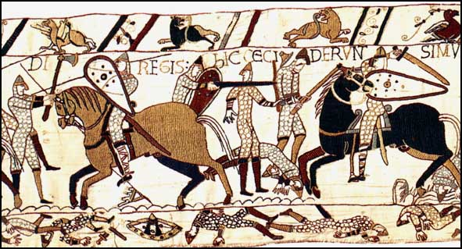
The Norman Conquest
In 1066, England was invaded by Normans (Vikings from modern-day France)
The Battle of Hastings
  Harold, King of England killed
  William of Normandy (William the Conqueror) takes over.
  Can YOU win the battle of Hastings?

Slide 24
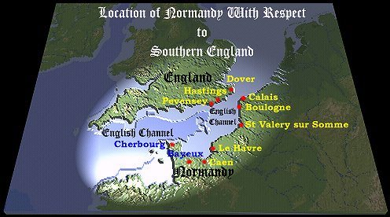

Slide 25
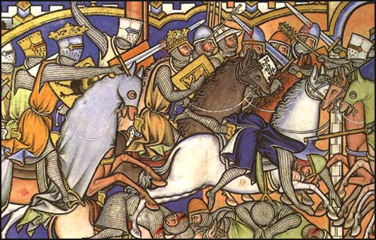
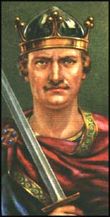
William of Normandy helped make England what it is today and codified feudalism (gave it the force of law).

Slide 26
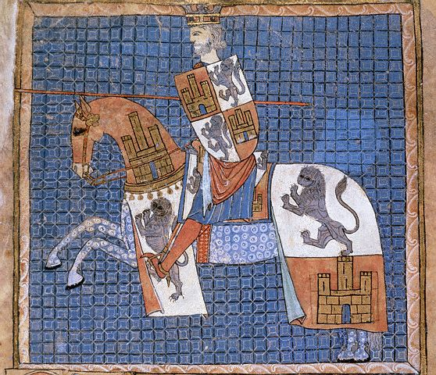
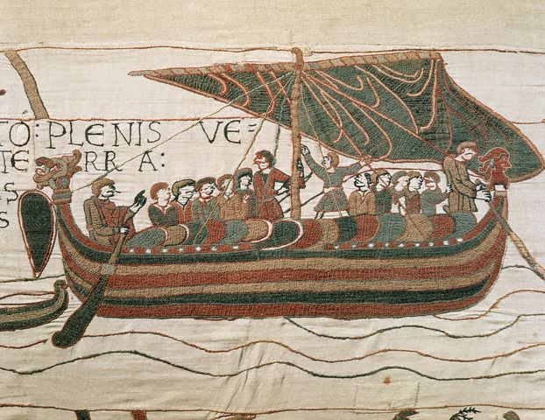
French was spoken in the English court for the next 200 years.
1066 - William I creates Domesday Book for purposes of fair tax collection.
  Great resource for modern historians to learn about Medieval life)
William of Normandy
Norman ship

Slide 27
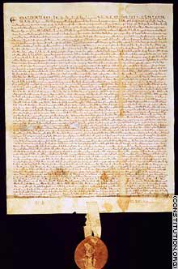
The Magna Carta
English King John was a bad king so his nobles forced him to sign it
Limited powers of king.
Signed in 1215
Example of Rule of Law

Slide 28
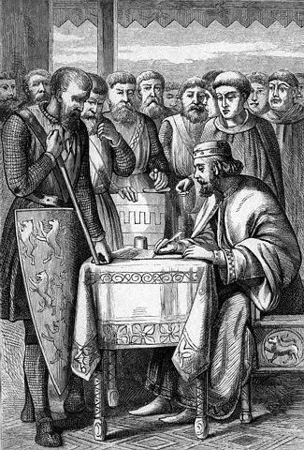
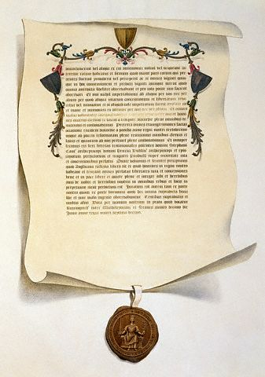
Magna Carta - 1215
No royal official shall take goods from any man without immediate payment.
No free man shall be imprisoned except by the lawful judgment of his equals or by the law of the land.
In future no official shall place a man on trial without producing credible witnesses.
Courts shall be held in a fixed place at a fixed time.
The barons shall elect a House of Lords for the creation of laws.
The English church shall be free.
For a trivial offence, a free man shall be fined only in proportion to the degree of his offence.
Due Process of Law

